Slide 1

Ims Project
Junaid Aziz

Slide 2




Introduction
I am a developer who Is part of Qa academy in which were learning technologies like Java , J- unit and frameworks such as Spring boot to create restful Api’s

Slide 3



Agenda

Slide 4
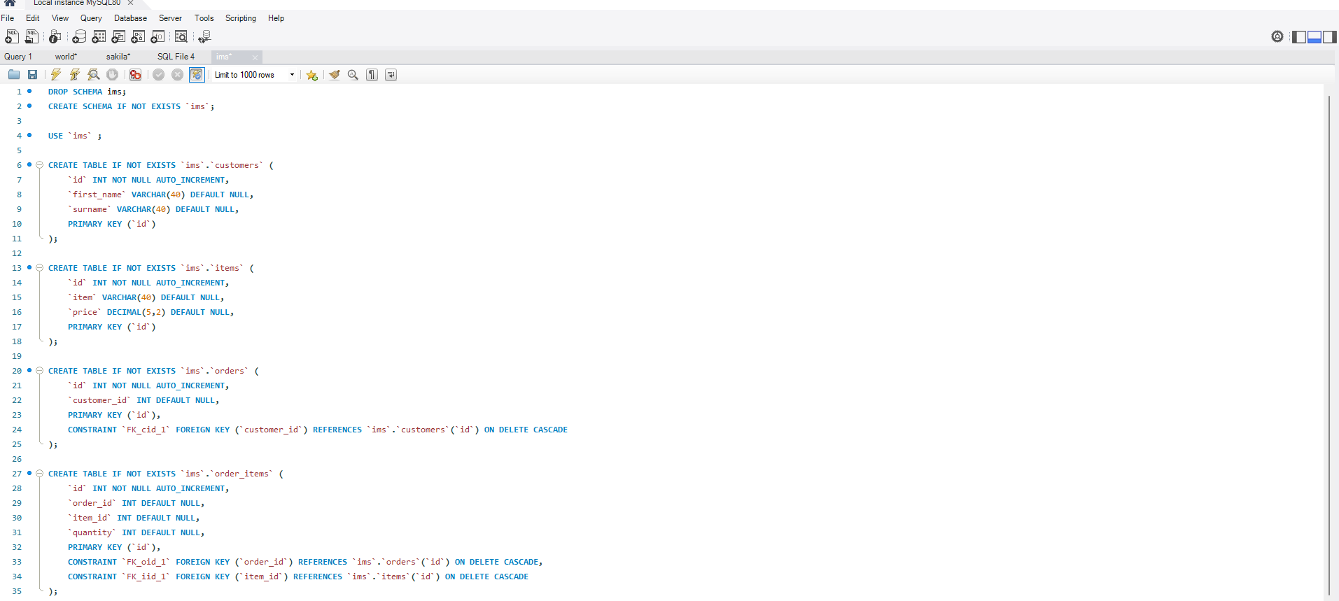
Game plan
I started with creating the database which was the main part for the app
Then I worked towards creating the front-end which was according to my plan.

Slide 5
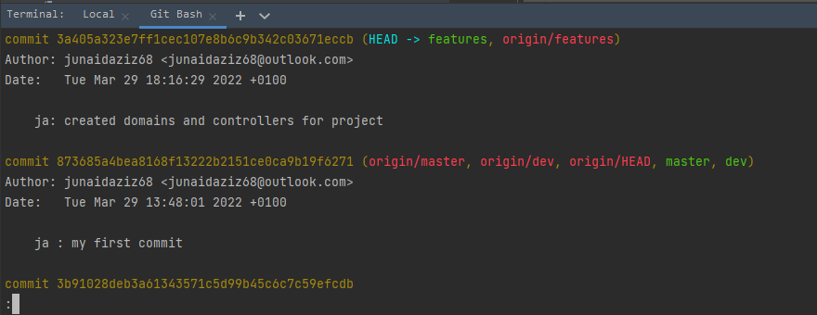
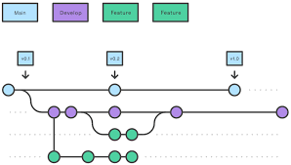
Continuous integration
I followed the Master/Dev/Features method to push and pull my work to GitHub

Slide 6
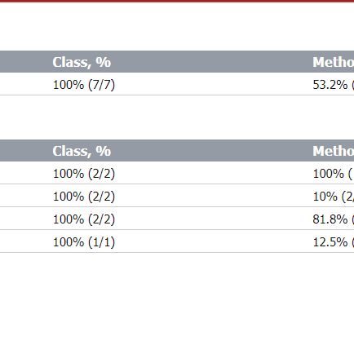
Testing
80% coverage was tested to ensure all classes and methods were working
CusotmerController
ItemController
OrderController

Slide 7
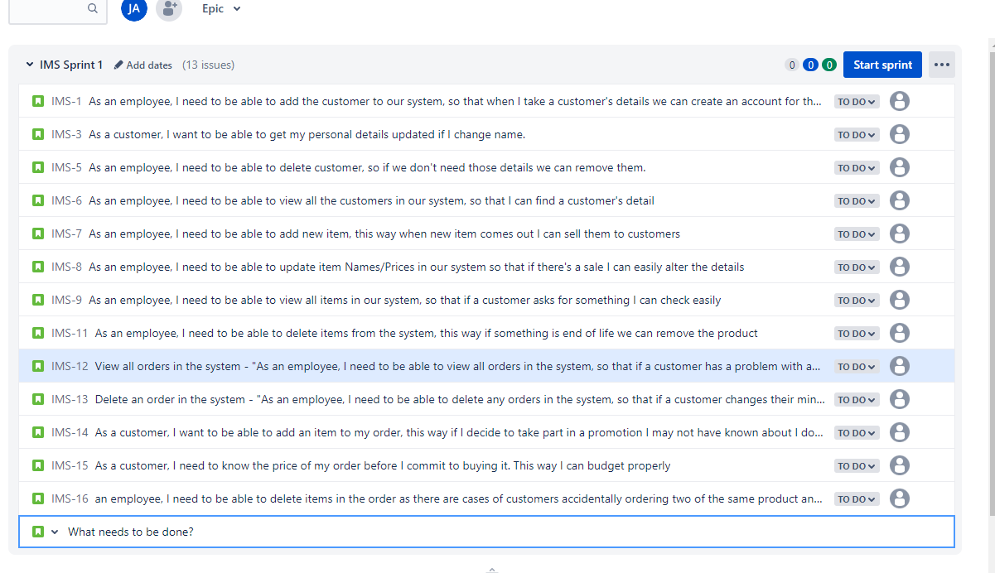
Demonstration

Slide 8
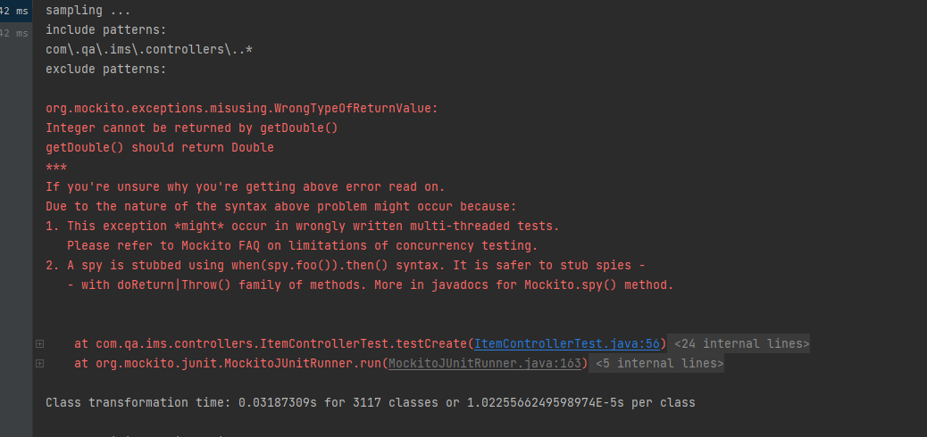
Errors I faced
Connection errors regarding JDBC
Order were not creating
Orders were not reading
Jdbc connection error when doing testing I tired to fix it but I couldn’t
Database not showing customers
Eclipse crashing and not working half way through the project

Slide 9
Sprint review
Completed
Left Behind
Completed Crud customer
Completed Item Crud
Completed order Crud
Testing some of it got left behind due to jdbc connection
Wanted to add multiple items in an order
Create a better looking logger to display information

Slide 10
Sprint Retrospective
What could be improved
What went well
Creating crud went amazing and also the database at first, I was having issues, but I managed to complete on time.
If I had more time with this technology add more functionality, then sticking to the basic.
Learning more about jdbc and creating this project again in my free time to understand

Slide 11
With PowerPoint, you can create presentations and share your work with others, wherever they are. Type the text you want here to get started. You can also add images, art, and videos on this template. Save to OneDrive and access your presentations from your computer, tablet, or phone.

Slide 12


Thank You
Presenter name
Email address
Website address

